Slide 1
CICD with jenkins day 3

Slide 2
Agenda
Revision on Lec 2
Jenkins slave
Complete jenkins pipeline project
Role based authorization, manage users and SSO concept
Jenkins shared library

Slide 3
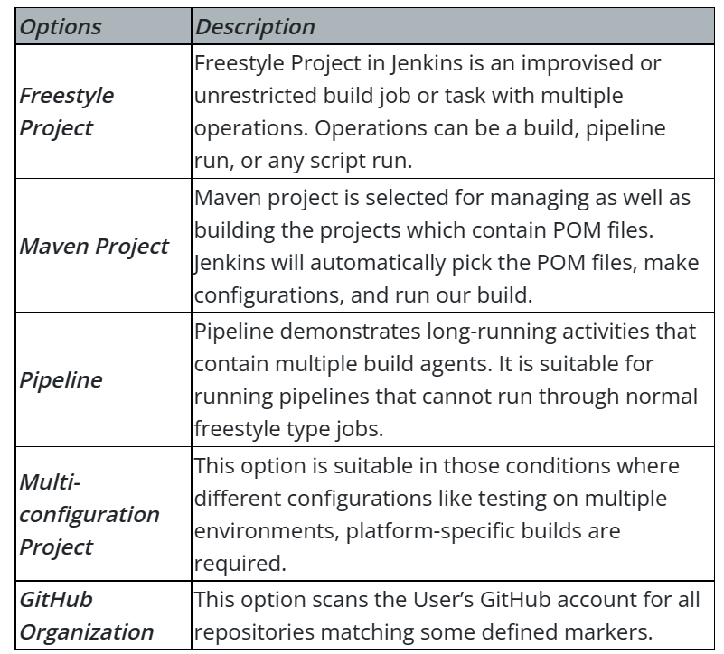
Types of job in jenkins

Slide 4
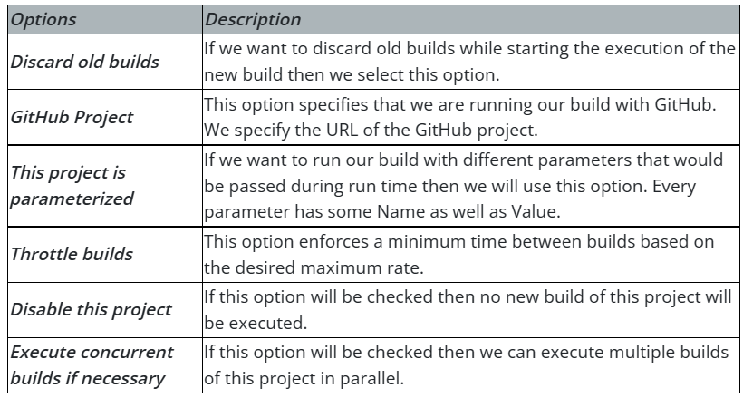
General option for jobs

Slide 5
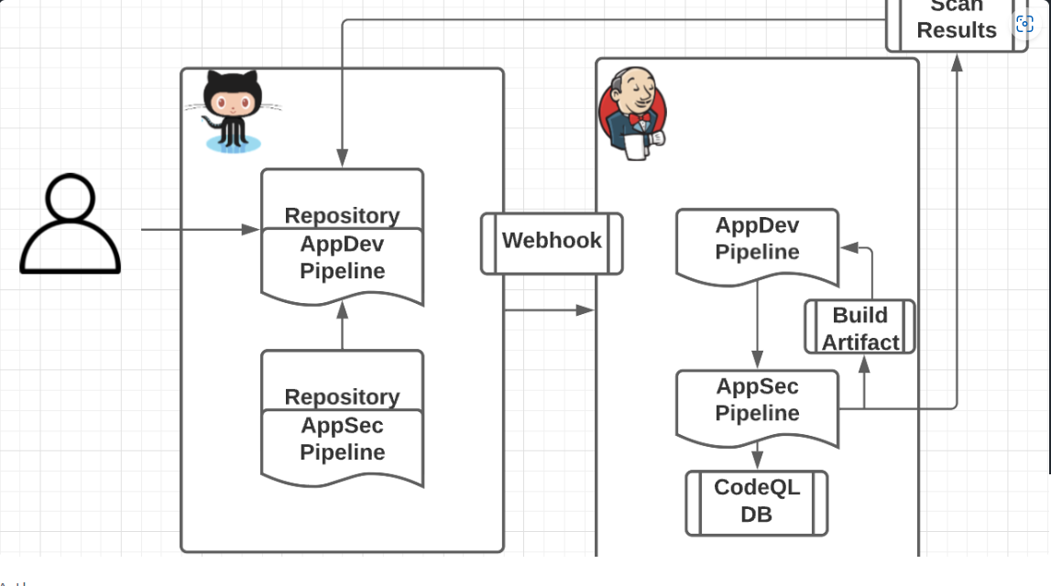
Webhook vs Jenkins scan

Slide 6
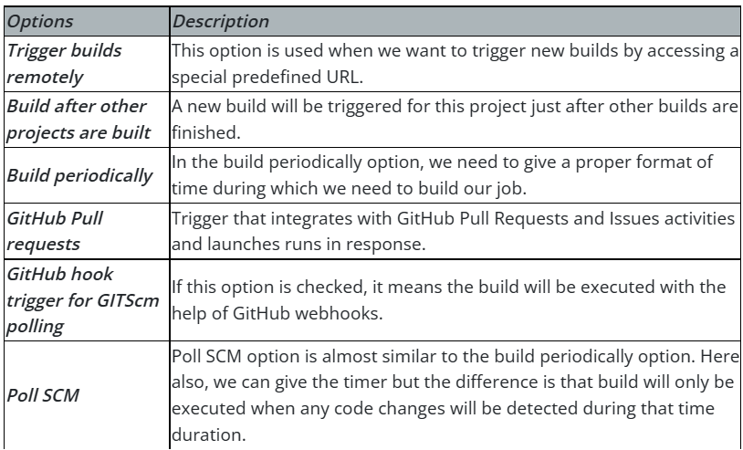
Types of trigger in jenkins

Slide 7
scripted vs declarative pipeline
The same, but different
Scripted vs. declarative pipelines are different only in their programmatic approach. One uses a declarative programming model, while the other uses an imperative programming model.
But they both run on the same Jenkins pipeline sub-system. There are no differences in the runtime performance, scalability and problem solvability perspective in the declarative vs. scripted pipeline debate. They only differ in the syntactic approach used to achieve an end goal.

Slide 8
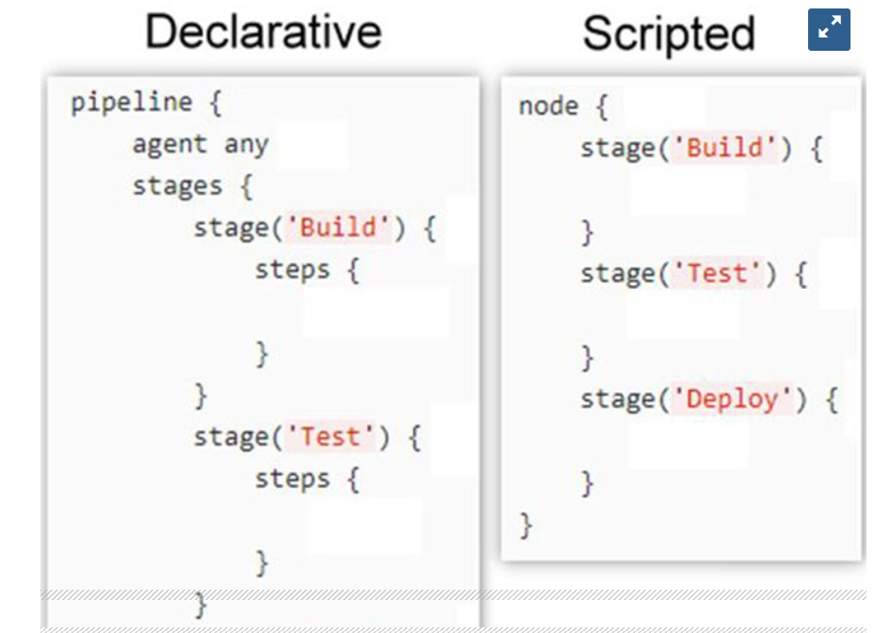
scripted vs declarative pipeline

Slide 9
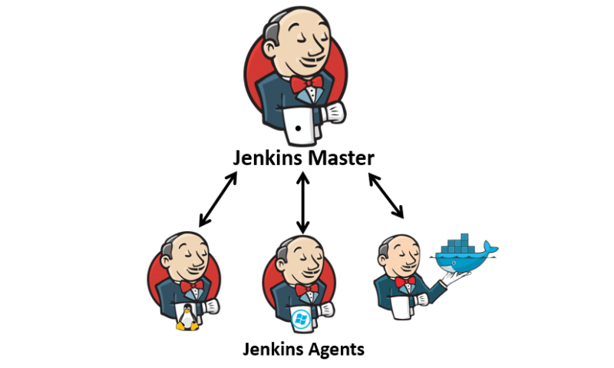
Jenkins slave

Slide 10
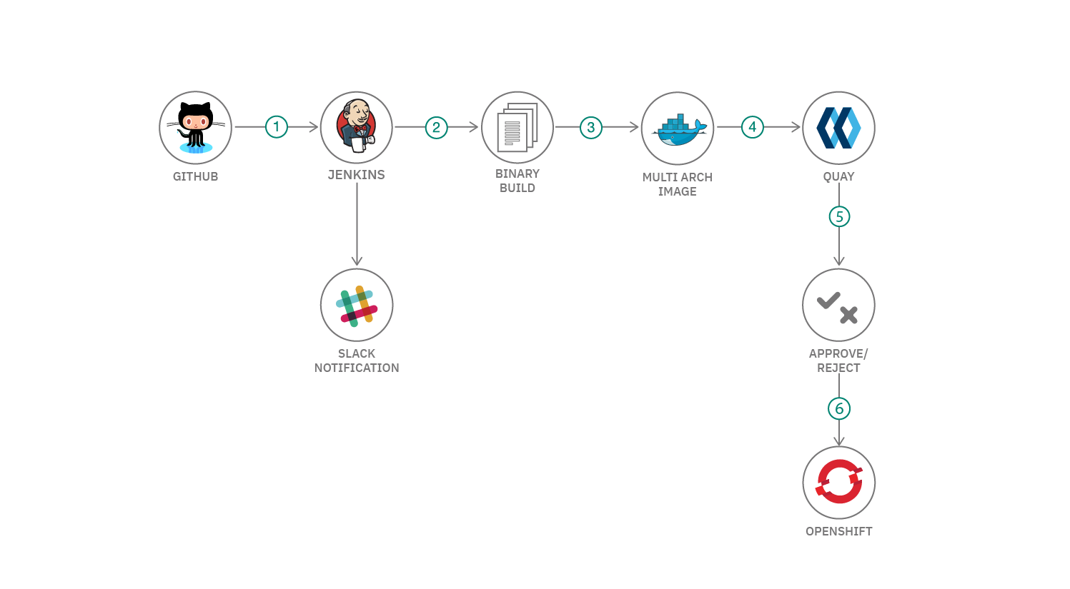

Complete jenkins pipeline project

Slide 11
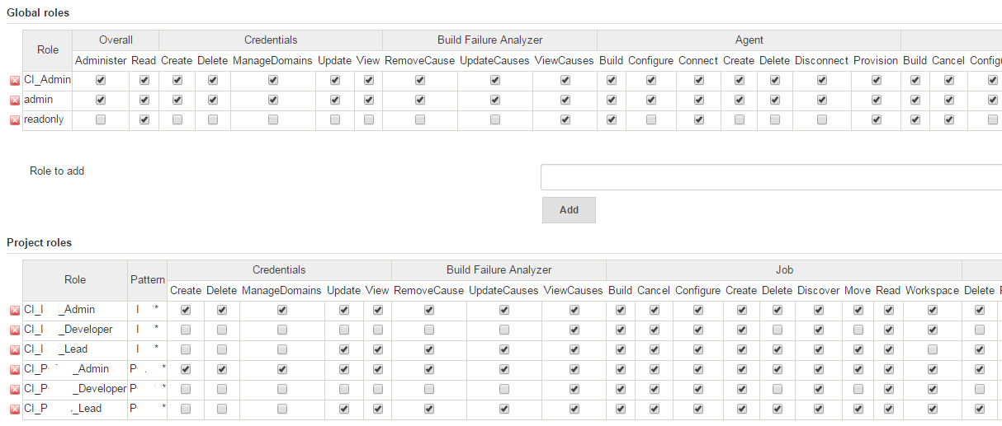
Role based authorization, manage users and sso concept

Slide 12
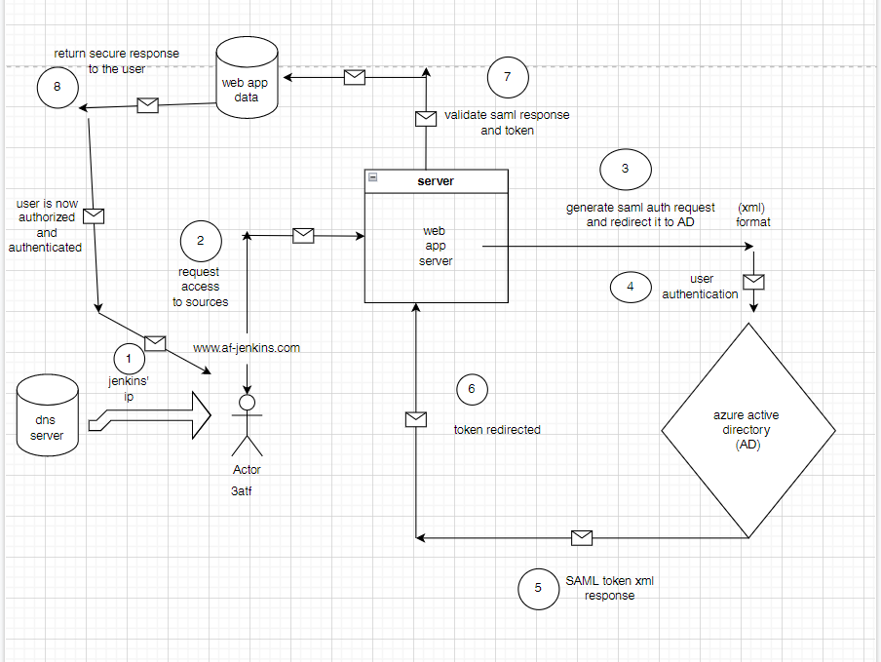
SSO (single sign on)

Slide 13
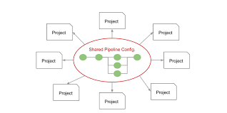
Jenkins shared library

Slide 14
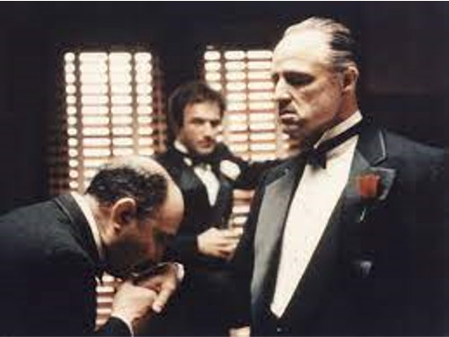


Slide 15
Q&A

Slide 16
Thank you

